Slide 1
Introduction to Scrum
Pete Deemer
CPO, Yahoo! India R&D
Notes:
Welcome to the program
Look at Scrum – one of the most popular agile development techniques
Workshop outline
Day 1 – introducing Scrum, terminology and principles
Day 2 – Scrum simulation, few other areas of theory
Questions – will park those that will get answered along the way
The objective of this session will not be to convince you that Scrum practices are required or to address every objection that we currently see to implement Scrum.
Set ground rules – use of phones, be present throughout

Slide 2
The Traditional Approach
Job Function A
Job Function B
Job Function C
Job Function D
Job Function E
Requirements Gathering
Design
Development
Documentation, Signoffs, Handoff
Testing
Documentation, Signoffs, Handoff
Rework
Documentation, Signoffs, Handoff
Documentation, Signoffs, Handoff
Notes:
Traditional approach or the waterfall approach to software development.
Specialize by job function. Ownership is limited to scope of job function – not the end result. Not aware of the big picture either.
All the good ideas must come at the start of the project. A good idea at the end is a disaster due to the impact and cost of change.
Dependence on written specifications – which are subject to misunderstanding.
Alarming industry statistics on project completion percentages. Only 7% are done on time within budget. A significant % are abandoned.
Few end users are happy with what they have received even if the project is successful by it’s operational metrics.

Slide 3
Agile: Iterative Incremental Development
Cross-Functional Team (Designers, Developers, Testers)
Feature A
Design Develop Test Rework
Feature B
Design Develop Test Rework
Feature C
Design Develop Test Rework
Feature D
Design Develop Test Rework
Feature E
Design Develop Test Rework
Notes:
Agile development – work in iterations
Take a feature based approach with cross functional teams. Design, development, testing and rework happens within each feature.
Rely less on specifications or documents but more on working code and usable software – part of agile manifesto.
Example of the restaurant. Imagine each of you are entertaining guests and go to a restaurant. The restaurant needs to make the most profit and satisfy customers as best as it can. Different people order different combinations.
Examples – sit down meal with 7 courses and accompanying wines
Chinese spread with hot butter cuttle fish and assortment of other dishes
Rice and chicken curry
Milkshakes and table water, Toothpicks
Describe how you would prioritize and serve the higher value customers before the rest.
Scrum vs. Scrum but. Scrum, 90% chance of success whereas Scrum-but will give you 90% chance of failure

Slide 4
Business Value
100
90
80
70
60
50
40
30
20
10
0
Business Value %
Month 1 | Month 2 | Month 3 | Month 4 | Month 5 | Month 6
Notes:
Let’s see business value. Ask people to model how business value is provided in waterfall – then on agile.
Traditionally – delivered late in the cycle. If the project is terminated early, everything is lost – no value at all.
Agile – deliver value early in the cycle. A project can be terminated early with most of the business value delivered. The 80/20 rule.
We will see later how business value is continually made a priority during every stage of the project.

Slide 5
Uncertainty and Risk
100
90
80
70
60
50
40
30
20
10
0
Uncertainty and Risk %
Month 1 | Month 2 | Month 3 | Month 4 | Month 5 | Month 6
Notes:
What about uncertainly and risk. How do you see this?
Do projects start with low and become higher or does it stay constant.
As you delivery functionality that works and is accepted by the user, the risk on that piece reduces.
The impact of failure is highest at the end of the project – cost, resources committed, time lost. The lower the risk and uncertainty the better it is as this stage.

Slide 6

AGILE
Scrum
eXtreme Programming
(“XP”)
Test-Driven
Development
(“TDD”)
Crystal DSDM FDD
and more…

Slide 7
The Emergence of Scrum
Scrum formalized in 1995 by Ken Schwaber and Jeff Sutherland
In use at many Fortune 100 companies globally
Google
Sun
Siemens
GE
TCS
IBM
Nokia
Infosys
HP
Motorola
Wipro
BT
Notes:
You find several IT service providers here as well – TCS, Infosys and Wipro.
Easier to implement within own enterprise, harder to succeed when it’s a pure client-vendor relationship.
Part of Scrum education is to teach clients on how to make Scrum successful.

Slide 8
Agile Challenges
It’s hard!
It requires significant change
It makes all dysfunction visible
Agile doesn’t fix anything: the team has to do it
It forces honesty and transparency
If you don’t address the problems, it will be painful
Bad products will be delivered sooner, and doomed projects will fail faster
Partial adoption may be worse than none at all
Be forewarned: many Agile adoptions fail
Notes:
Now, if you have all these benefits why isn’t it becoming mainstream and used by anybody and everybody?
Seems like a no-brainer for a team to adopt Scrum.
Requires radical change in the organization and points of interaction. People, processes and tools.
Requires around 5 sprints to stabilize and establish a rhythm that is productive.
Will reveal issues that you need to fix – e.g. lack of team skills
Core practices – cannot have a partial adoption, means disaster:
Team gets to commit to the work instead of it being assigned to them
The quantum of work does not change during the sprint.

Slide 9
The Agile Manifesto – 2001
We are uncovering better ways of developing
software by doing it and helping others do it.
Through this work we have come to value:
Individuals and interactions over processes and tools
Working software over comprehensive documentation
Customer collaboration over contract negotiation
Responding to change over following a plan
That is, while there is value in the items on
the right, we value the items on the left more.

Slide 10
The Essence of Scrum
SCRUM
Timebox
Commit
No Changes
Inspect
Adapt
Notes:
The basic Scrum workflow.
Pressure on the team to overcommit – both subtle and direct orders. Sets up a pattern of failure.
Results in the team accepting failure of not meeting the sprint commitments as the norm – doesn’t deliver any real value
Team morale goes down as there is always an unattainable goal which is imposed on them
Burnout is common as the team is continually pushed to overcommit or forced to cut corners.
Sometimes the pressure to overcommit can be subtle – where there are hints given on expectations.

Slide 11
SCRUM
Project Start
Project End
Sprint
Sprint
Sprint
Sprint
Sprint
Sprint
Sprint
Sprint
Notes:
Sprints are conducted at a sustainable pace. High intensity but not necessarily long hours.
Focus on productivity and minimizing rework.
Work smart – not hard (or late hours).
Results in burnout otherwise.
A typical sprint would be either 2 weeks of 4 weeks – not over 4 weeks, if so, it is not Scrum.
Typical team size is 7 plus or minus 2.

Slide 12




SCRUM
ScrumMaster
Input from End-Users,
Customers, Team and Other Stakeholders
Product
Backlog
Refinement
Daily Scrum Meeting and Artifacts Update
“The Scrum Team”
Sprint
1-4 Weeks
Product Owner
Team
Review
1
1
Team Selects
How Much To Commit To Do By Sprint’s End
2
2
3
3
TASKS
FEATURES
FEATURES
4
4
5
5
Potentially Shippable Product
Increment
6
6
No Changes
in Duration or Goal
7
7
8
Sprint Planning
Meeting
Sprint Backlog
9
10
11
12
Product Backlog
Retrospective

Slide 13
SCRUM
ScrumMaster
Input from End-Users,
Customers, Team and Other Stakeholders
Product
Backlog
Refinement
Daily Scrum Meeting and Artifacts Update
Sprint
1-4 Weeks
Product Owner
Team
Review
1
1
Team Selects
How Much To Commit To Do By Sprint’s End
2
2
3
3
TASKS
FEATURES
FEATURES
4
4
5
5
Potentially Shippable Product
Increment
6
6
No Changes
in Duration or Goal
7
7
8
Sprint Planning
Meeting
Sprint Backlog
9
10
11
12
Product Backlog
Retrospective
Notes:
Main roles:
ScrumMaster – acts as the servant and body guard of the team
Product Owner – acts as a guide to ensure that what is being built continually adds value and is focused on the highest priorities – set the right direction
Team – makes progress and gets the work done based on the commitments made and up to expectations of the Definition of Done.
All others have to either help the team or get out of the way!

Slide 14
SCRUM
ScrumMaster
Input from End-Users,
Customers, Team and Other Stakeholders
Product
Backlog
Refinement
Daily Scrum Meeting and Artifacts Update
Sprint
1-4 Weeks
Product Owner
Team
Review
1
Team Selects
How Much To Commit To Do By Sprint’s End
2
3
TASKS
FEATURES
4
5
Potentially Shippable Product
Increment
6
No Changes
in Duration or Goal
7
8
Sprint Planning
Meeting
Sprint Backlog
9
10
11
12
Product Backlog
Retrospective

Slide 15
The Product Owner
Product Owner is the one and only person responsible for managing the Product Backlog
Decides what is on the Product Backlog
Decides the order of priority of Product Backlog items
Evolves the Product Backlog over time
One person, not a committee
Committee may exist to influence or advise
The Product Owner’s decisions are visible in the content and prioritization of the Product Backlog
This visibility requires the Product Owner to do his or her best
The Product Owner manages the release schedule and decides when the product is ready to ship
Notes:
One person – is the final decision maker in terms of what has to be built.
Example – the product owner is like the person controlling the rudder of a ship. The team are the rowers, the product owner set’s the course for the journey.
Large initiatives can have multiple product owners for different areas but one team will only have a single product owner for directions and priority setting.

Slide 16
SCRUM
ScrumMaster
Input from End-Users,
Customers, Team and Other Stakeholders
Product
Backlog
Refinement
Daily Scrum Meeting and Artifacts Update
Sprint
1-4 Weeks
Product Owner
Team
Review
1
Team Selects
How Much To Commit To Do By Sprint’s End
2
3
TASKS
FEATURES
4
5
Potentially Shippable Product
Increment
6
No Changes
in Duration or Goal
7
8
Sprint Planning
Meeting
Sprint Backlog
9
10
11
12
Product Backlog
Retrospective

Slide 17
The Team
Team of developers that turns an increment of Product Backlog into an increment of potentially shippable functionality every Sprint
7 people, + or – 2
Sitting together and 100% dedicated to the Sprint
Team is cross-functional
Includes all the skills necessary to produce an increment of potentially shippable product: coding, testing, architecture, documentation
Team takes on tasks based on skills, not just official “role”
Team is self-organizing
Team decides what to commit to and how to get it done
Team composition does not change during Sprint
Notes:
Why 7 +or- 2 as the team size? Reduce communication overhead that is common as the team size grows.
A group of 7 can sit together, see each other, talk to each other without raising their voices
Dedicated to the project 100%. Cannot have partial allocations where there is a conflict of interests.
Serves to reduce context switching, where productivity is lost due to shuffling between tasks.
Do the example of the context switching exercise.
Stress on the importance of self organizing as opposed to being managed.
Self organization exercise for the team.
Ask everyone to stand up
I want you to form a single line or human chain with everyone in this room
Everyone has to be moving all the time – no one can be stationary at any point
You have to go around alternate tables during exercise
On the count of three – move

Slide 18
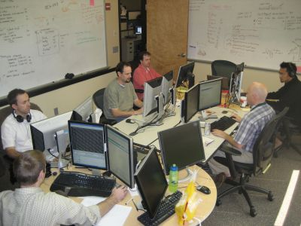
Notes:
Have plenty of whiteboard space
Paper based charts – information radiators, as opposed to online dashboards or excel sheets where information is not immediately visible
Ideally located in a conference room or where partition panels are removed.
Dual monitors are made available.
Point out to the balance between proximity and protecting productivity. E.g. the person with headphones off vs. headphones on.

Slide 19
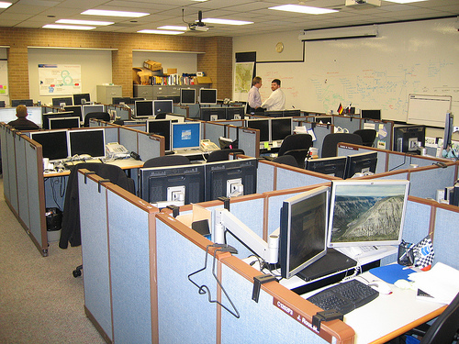

Slide 20
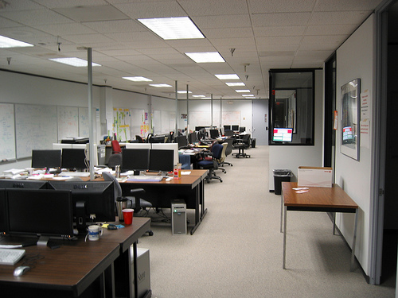

Slide 21
SCRUM
ScrumMaster
Input from End-Users,
Customers, Team and Other Stakeholders
Product
Backlog
Refinement
Daily Scrum Meeting and Artifacts Update
Sprint
1-4 Weeks
Product Owner
Team
Review
1
Team Selects
How Much To Commit To Do By Sprint’s End
2
3
TASKS
FEATURES
4
5
Potentially Shippable Product
Increment
6
No Changes
in Duration or Goal
7
8
Sprint Planning
Meeting
Sprint Backlog
9
10
11
12
Product Backlog
Retrospective

Slide 22
The ScrumMaster
Serves and protects the Team
Removes obstacles and shields from threats
Responsible for ensuring the Team and Product Owner adhere to Scrum values, practices, and rules
Helps the Team and Product Owner – and the organization – adopt Scrum
Teaches Scrum to everyone
Coaches and leads the Team and Product Owner to be more productive and produce higher quality products
ScrumMaster does not manage the Team
Team is self-organizing
Notes:
Everyone can feel that they don’t have the right skills or attitudes to be a ScrumMaster.

Slide 23
Choosing the ScrumMaster
Traits of an effective ScrumMaster
Highly committed to the success of the team
Good people skills
Good communication skills
Observant, good listener
Courageous mindset
Proactive, helpful personality
Best results will come from a full-time ScrumMaster
If dedicated person is not available, a team-member will have to play the role, and take a much lighter load of tasks
Avoid having the team’s manager be ScrumMaster
Team will still look to this person for micromanagement, and will not self-organize or self-manage
Notes:
The ScrumMaster can never say “That’s not my job”. Do anything and everything to help the team be successful.
Example of the childcare assistance to help a key team member. You would never think of doing some of those tasks when you come to work in the morning!
The ScrumMaster ends up calling the local yellow pages advertising child minding services and interviewing suitable candidates to support the team member.
In a way, you take on the uncertainties to help, remove obstacle and protect the productivity of the team.
GATT – Go Ask The Team, avoid boss like behavior or be a ‘know it all’

Slide 24
Scrum Meetings and Artifacts
Pete Deemer
CPO, Yahoo! India R&D

Slide 25
Sprint Planning Meeting
Team calculates how much time it will have available during the Sprint
Team takes first item from Product Backlog and breaks it into tasks
Team estimates how long the tasks will take
If there’s available time remaining, move to the next item on Product Backlog and repeat 1-3
Notes:
The sprint planning meeting consists of two parts:
Part 1 (What)
Discuss high priority items intend to implement in the sprint
Team gets an insight to product owners thinking
Review the ‘Definition of done’ – get a common understanding and agreement
Part 2 (How)
Estimate the time available for the team
Task generation (usually < 1 day)
Estimates each task
Product owner can leave. He needs to be reachable for clarifications
Inputs
Product backlog
Latest increment of the product
Teams capacity
Past performance of the team
Time boxed – 5% from the sprint
4 hrs for a sprint of 4 weeks

Slide 26
Backlog Item #1
Backlog Item #2
Backlog Item #3
Backlog Item #5
Blow up 10 balloons
Mark intervals of >30cm on string
Blow Up 10 Balloons
Blow Up 10 Balloons
Blow Up 10 Balloons
Measure diameter of all balloons
Tie all balloons onto string
Measure Radius of All 10 Balloons
Measure Radius of All 10 Balloons
Write Volumes on Sheet of Paper
Write diameter on all balloons
Double-check measure-ments
Calculate Volume of All 10 Balloons
Calculate Volume of All 10 Balloons
Tasks to Complete | Owner | Initial Est. | Day 1 | Day 2 | Day 3 | Day 4
Blow up 5 Balloons |  | 10
Measure diameter of balloons |  | 5
Write diameter on balloons |  | 3
Mark intervals of >30cm on balloons |  | 2
Tie balloons to string |  | 3
Double-check measurements |  | 2
Roll newspaper into tube and table |  | 5
Measure height |  | 4
Test weight strength |  | 1
Construct 10 paper airplanes |  | 5
Flight test each airplane, sign and write time |  | 5
Destroy airplanes that fail, replace and retest |  | 3
Translate Martian message |  | 15
Write message neatly on new sheet of paper |  | 5
 | TOTAL | 68
BURNDOWN CHART
TOTAL MINUTES OF WORK LEFT TO DO
Initial Estimate
Day 1
Day 2
Day 3
Day 4
Notes:
Sprint backlog –
Created during the sprint planning meeting
Breakdown the product backlog tasks into granular tasks
Fully owned by the team – Only team can commit to what it can implement in the up coming sprint
> Cross functional team – Not required to volunteer for all the task at the beginning. Just-in-time scheduling
Living document - Not a document that you create and put into a drawer, lock it and no one will see it again.
Updated daily as the team progresses
Sprint burndown charts
X axis – Time in the Sprint, number of days
Y axis – Work remaining to be done
Plot the initial point and last day of the sprint. Draw a straight line. This will be the idealized line for the team.
However, in most cases down words slope is not seen. This is the reality of the development.
Team needs to take corrective actions. (eg. Descope, arrangements to get the work done effectively, etc)

Slide 27
Daily Scrum Meeting
Goal
Keep team coordinated and up-to-date with each other
Surface “blocks” or problems daily
Everyone stands in a circle, facing each other
Lasts 15 minutes or less
Everyone reports 3 things
What did I do since the last meeting
What will I do by the next meeting
What are my “blocks” or problems
No discussion until after meeting ends
Recommended: Team and SM only (no others)
After the meeting, ScrumMaster helps remove the blocks and help find solutions to the problems
Notes:
Key Inspect & Adapt practice
Inspection of progress towards sprint goals
Teams STANDS in a circle facing each other
Lasts not more than 15 mins
Attended by Team ONLY
Reports – What I did since the last daily scrum, What I will be doing today, Blocking issues.
ScrumMaster helps to clear the blocks. Team owns and re-organized
Follow up meetings usually happens to adapt the changes
Exercise – A team member is facing an issue as her babies nanny did not come back after the vacation. As a scrum master/team what would you do? Make into pairs – discuss and present. 1+3+3
NOT
Not a status update to the management
No discussions
No managers

Slide 28
Backlog Item #1
Backlog Item #2
Backlog Item #3
Backlog Item #5
Blow up 10 balloons
Mark intervals of >30cm on string
Blow Up 10 Balloons
Blow Up 10 Balloons
Blow Up 10 Balloons
Measure diameter of all balloons
Tie all balloons onto string
Measure Radius of All 10 Balloons
Measure Radius of All 10 Balloons
Write Volumes on Sheet of Paper
Write diameter on all balloons
Double-check measure-ments
Calculate Volume of All 10 Balloons
Calculate Volume of All 10 Balloons
Tasks to Complete | Owner | Initial Est. | Day 1 | Day 2 | Day 3 | Day 4
Blow up 5 Balloons |  | 10
Measure diameter of balloons |  | 5
Write diameter on balloons |  | 3
Mark intervals of >30cm on balloons |  | 2
Tie balloons to string |  | 3
Double-check measurements |  | 2
Roll newspaper into tube and table |  | 5
Measure height |  | 4
Test weight strength |  | 1
Construct 10 paper airplanes |  | 5
Flight test each airplane, sign and write time |  | 5
Destroy airplanes that fail, replace and retest |  | 3
Translate Martian message |  | 15
Write message neatly on new sheet of paper |  | 5
 | TOTAL | 68
BURNDOWN CHART
Sanjay
6
Anjana
0
TOTAL MINUTES OF WORK LEFT TO DO
Vikram
8
Priya
13
Initial Estimate
Day 1
Day 2
Day 3
Day 4

Slide 29
Backlog Item #1
Backlog Item #2
Backlog Item #3
Backlog Item #5
Blow up 10 balloons
Mark intervals of >30cm on string
Blow Up 10 Balloons
Blow Up 10 Balloons
Blow Up 10 Balloons
Measure diameter of all balloons
Tie all balloons onto string
Measure Radius of All 10 Balloons
Measure Radius of All 10 Balloons
Write Volumes on Sheet of Paper
Write diameter on all balloons
Double-check measure-ments
Calculate Volume of All 10 Balloons
Calculate Volume of All 10 Balloons
Tasks to Complete | Owner | Initial Est. | Day 1 | Day 2 | Day 3 | Day 4
Blow up 5 Balloons |  | 10
Measure diameter of balloons |  | 5
Write diameter on balloons |  | 3
Mark intervals of >30cm on balloons |  | 2
Tie balloons to string |  | 3
Double-check measurements |  | 2
Roll newspaper into tube and table |  | 5
Measure height |  | 4
Test weight strength |  | 1
Construct 10 paper airplanes |  | 5
Flight test each airplane, sign and write time |  | 5
Destroy airplanes that fail, replace and retest |  | 3
Translate Martian message |  | 15
Write message neatly on new sheet of paper |  | 5
 | TOTAL | 68
BURNDOWN CHART
Sanjay
6
Anjana
0
TOTAL MINUTES OF WORK LEFT TO DO
Vikram
8
Priya
13
Initial Estimate
Day 1
Day 2
Day 3
Day 4
Notes:
> Updates estimated work reaming in sprint backlog
> Adds up the total
> Plot in the sprint burndown chart
Highly visible picture of the work
Usually does not go with the idealized line
In this case, team needs to adjust (eg reduce scope, find out ways to get the work done effectively)

Slide 30
Backlog Item #1
Backlog Item #2
Backlog Item #3
Backlog Item #5
Blow up 10 balloons
Mark intervals of >30cm on string
Blow Up 10 Balloons
Blow Up 10 Balloons
Blow Up 10 Balloons
Measure diameter of all balloons
Tie all balloons onto string
Measure Radius of All 10 Balloons
Measure Radius of All 10 Balloons
Write Volumes on Sheet of Paper
Write diameter on all balloons
Double-check measure-ments
Calculate Volume of All 10 Balloons
Calculate Volume of All 10 Balloons
Tasks to Complete | Owner | Initial Est. | Day 1 | Day 2 | Day 3 | Day 4
Blow up 5 Balloons |  | 10
Measure diameter of balloons |  | 5 | 5
Write diameter on balloons |  | 3 | 3
Mark intervals of >30cm on balloons |  | 2 | 2
Tie balloons to string |  | 3 | 3
Double-check measurements |  | 2 | 2
Roll newspaper into tube and table |  | 5
Measure height |  | 4 | 4
Test weight strength |  | 1 | 1
Construct 10 paper airplanes |  | 5
Flight test each airplane, sign and write time |  | 5 | 5
Destroy airplanes that fail, replace and retest |  | 3 | 3
Translate Martian message |  | 15
Write message neatly on new sheet of paper |  | 5 | 5
 | TOTAL | 68 | 60
BURNDOWN CHART
Sanjay
6
Anjana
0
TOTAL MINUTES OF WORK LEFT TO DO
Vikram
8
Priya
13
Initial Estimate
Day 1
Day 2
Day 3
Day 4

Slide 31
BURNDOWN CHART
85
80
75
70
65
60
55
50
45
40
35
TOTAL MINUTES OF WORK LEFT TO DO
30
25
20
15
10
5
0
Initial Estimate
Day 1
Day 2
Day 3
Day 4

Slide 32
Sprint Review
Goal
Get hands on with what’s been built
Inspect the quality
Come up with ideas for improvements
See whether the commitment was completed
Attended by everyone
Product Owner, Team, ScrumMaster, stakeholders… and end users!
It’s a demo, not a Powerpoint show
Usually lasts 1-2 hours
Make it informal and fun
Notes:
Key practice of Inspect & Adapt
Time boxed – (5% of sprint)
Happens at the end of the sprint
Carry of inspect and adapt activities w.r.t Product – A demo of the product and in-depth conversation
Time for product owner to know the status of the product (What has been done, What’s not)
Time for team to understand what is going on with the product owner (market, changes, etc)
In-depth discussion with the product owner and the team (Advices, learn the situations etc)
Balanced b/w a demo and the conversation
Scrum master presents what is not align with the definition of done – Partially done – Not fake on quality
P.O, S.M, team, Customers, Experts & anyone interested can attend and give suggestions
Valuable input to next sprint planning meeting
NO
No slideware
Not fully focused on demo – Balanced

Slide 33
Sprint Retrospective
Goal
Find ways to improve the team’s way of working in the next Sprint
Attended by Team and ScrumMaster
Product Owner and managers should join for part (but not all) of the Retrospective
Team needs time to talk by itself
Usually lasts 1-2 hours
One Way to Do It
Make 4 lists
What Went Well (During the Sprint)
What Could Have Been Better (During the Sprint)
Things to Try (To Do Better in the Next Sprint)
Issues to Escalate (To Upper Management)
Notes:
Inspect and adapt w.r.t process (people, tools, relationships, etc)
Attend by Team, Product owner not required
Identify
What went well
What could have done better
Things to try
Issues
Usually lasts 1-2 hours informal team

Slide 34
SCRUM
ScrumMaster
Input from End-Users,
Customers, Team and Other Stakeholders
Product
Backlog
Refinement
Daily Scrum Meeting and Artifacts Update
Sprint
1-4 Weeks
Product Owner
Team
Review
1
Team Selects
How Much To Commit To Do By Sprint’s End
2
3
TASKS
FEATURES
4
5
Potentially Shippable Product
Increment
6
No Changes
in Duration or Goal
7
8
Sprint Planning
Meeting
Sprint Backlog
9
10
11
12
Product Backlog
“Definition of Done”
Retrospective

Slide 35
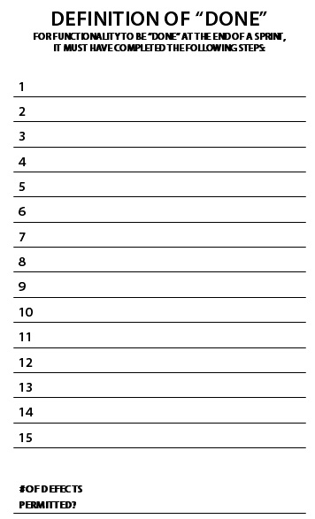
Code complete
Code reviewed
Unit tested
Integrated
Documented
No P1 defects, <3 P2 defects
Notes:
Scrum teams produce potentially shippable increment at end of each sprint
So these must be a complete slice of work – Work should be ‘Done’
Is everyone clear on what is meant by ‘Done’
Various methods available
Team needs to select what best for their context

Slide 36
Scrum Tools
First Question – Do you really need a tool?
If yes, well-known commercial tools include
ScrumWorks
Rally Software
VersionOne
XPlanner

Slide 37
Release Planning and Estimation in Scrum
Pete Deemer
CPO, Yahoo! India R&D

Slide 38
Team A
1
1
1
1
1
1
1
1
1
1
1
2
2
2
2
2
2
2
2
1
4
3
3
3
Sprint 1
Sprint 2
Sprint 3
14 Points
of functionality
12 Points
of functionality
15 Points
of functionality
Average of ~14 Points per Sprint
➔ “Velocity”

Slide 39

The Product Backlog
Priority | Description | Size (to build)
1 | Feature A | 3
2 | Feature B | 4
3 | Feature C | 3
4 | Feature D | 2
5 | Feature E | 4
6 | Feature F | 4
7 | Feature G | 3
8 | Feature H | 5
9 | Feature I | 2
10 | Feature J | 4
11 | Feature K | 2
12 | Feature L | 4
Total = 40 points
Velocity = 14 points
Time to complete =
40/14 = 2.8 Sprints

Slide 40
Product Backlog Estimation
We are estimating the SIZE of each Product Backlog Item
SIZE = Effort x Complexity x Uncertainty
How long will it take to do
How difficult will it be to do
How unsure are we of the requirements or implementation
Everyone estimates the whole size (design, code, test, etc.)

Slide 41
Priority | MoSCoW | User Story | Size
1 | Must Have | As a Clockazon user, I want to be able to type the Clockazone URL in my browser and load Clockazon’s home page | 3
2 |  | As a Clockazon user, I want to click the "buy" button to put a clock in my shopping cart | 5
3 |  | As a Clockazon user, I want to complete the purchase of the items in my shopping cart | 8
4 |  | As a Clockazon user, I want to receive an email with the details of my order, after it’s finishing processing | 3
5 |  | As the shipping manager, I want to log onto the system and see the orders that need to be shipped | 5
6 |  | As the shipping manager, I want to print a shipping label and packing list | 5
7 |  | As a Clockazon user, I want to click the shopping cart icon and see what’s in my shopping cart | 3
8 |  | As a Clockazon user, I want to remove an item from my shopping cart, or change the quantities | 3
9 |  | As a Clockazon user, I want to see a page that shows detailed information about a single clock (such as price, specifications, user reviews, etc.), along with thumbnail photos of the clock | 5
10 |  | As a Clockazon user, I want to click on a thumbnail photo to see a full-size photo of the clock | 2
11 |  | As a Clockazon user, I want to select a type of clock (wristwatch, alarm clock, etc.), and see the clocks of that type | 3
12 |  | As a Clockazon user, I want to select a manufacturer, and see all the clocks available from that manufacturer | 5
13 |  | As a Clockazon user, I want select a number of rating stars, and see all the clocks that were rated at that level or higher | 5
14 |  | As a Clockazon user, I want to see a list of clocks that have reduced prices or are “on sale” | 5
15 |  | As a Clockazon user, I want to enter a piece of text and click “search clocks”, and then see a list of all clocks that match any part of that text (product search) | 8
16 |  | As a Clockazon user, I want to be able to log in and enter a star rating (1-5 stars) for a product which I have purchased, for several different criteria (timekeeping accuracy, value for money, etc.) | 3
17 |  | As a Clockazon user, I want to log onto my account and see whether my order has shipped or not | 5
18 |  | As the promotions manager, I want to be able to show a list of all the clocks in our inventory, and be able to enter a sale price for any or all of them | 13
19 |  | As the promotions manager, I want to enter free-form HTML for the content of a promotional box on the home page | 5
20 |  | As the sales manager, I want to upload the specifications, pricing, and photos for a single clock | 8
21 |  | As the sales manager, I want to do a bulk upload of clock specifications, pricing, and photos | 13
22 |  | As the shipping manager, I want to look up the status of a particular order | 5
23 |  | As the shipping manager, I want to change the status of a particular order | 5
24 |  | As the business manager, I want to generate a report showing total sales for a period of time | 8
25 | Should Have | As a Clockazon user, I want to select a price range, and see all the clocks that are within that price range | 3
26 |  | As a Clockazon user, I want to see a list of “new arrivals” (clocks that have recently been added to the Clockazon inventory) | 3
27 |  | As a Clockazon user, I want see a list of the best-selling clocks on the site | 5
28 |  | As a Clockazon user, I want to enter a piece of text and click “search website”, and then see a list of every page on the website that matches any part of that text (freeform search) | 8
29 |  | As a Clockazon user, I want to be able to log in and type a free-form text review for a product which I have purchased | 8
30 |  | As a Clockazon user, I want to set up an account to save my credit card and other info to use on later visits | 8
31 |  | As a Clockazon user, I want to log onto my account and view and edit my account details | 5
32 |  | As a Clockazon user, I want to receive an email to let me know that my clock has shipped | 5
33 |  | As a Clockazon user, I want to have a lost password sent to me via email | 2
34 |  | As the promotions manager, I want to schedule different clocks to be featured on the home page | 8
35 |  | As the sales manager, I want to select a clock and edit any of the information stored for that clock | 3
36 |  | As a registered Clockazon customer, I want to create a public profile page that shows the different clocks I own, what kinds of clocks I’m interested in | 13
37 |  | As a registered Clockazon customer, I want to be able to post messages in a discussion area, so that I can interact with other clock enthusiasts | 13
38 | Could Have | As a Clockazon user, I want to get a recommendation of clocks that I might like, based on the star ratings I’ve given to other clocks, compared with the star ratings of other users | 13
39 |  | As a registered Clockazon customer, I want to place a Clockazone module on my Facebook page which shows all the clocks I own | 13
40 |  | As a registered Clockazon customer, I want to place a Clockazone module on my Myspace page which shows all the clocks I own | 13
 |  | TOTAL | 256
Team’s previous velocity
= 24 per Sprint
Theoretically,
whole backlog would take
256 / 24 = 10.6 Sprints
Estimation Buffer
Rework Buffer
Additions Buffer
Pre-Release Sprint
+15%
+10%
+10%
Full List
= 256

Slide 42
Pre-Release Sprint
RELEASE
S P R I N T
S P R I N T
S P R I N T
S P R I N T
S P R I N T
PRE-RELEASE S P R I N T
FINAL STABILIZATION AND RELEASE PREPARATION

Slide 43
Priority | MoSCoW | User Story | Size
1 | Must Have | As a Clockazon user, I want to be able to type the Clockazone URL in my browser and load Clockazon’s home page | 3
2 |  | As a Clockazon user, I want to click the "buy" button to put a clock in my shopping cart | 5
3 |  | As a Clockazon user, I want to complete the purchase of the items in my shopping cart | 8
4 |  | As a Clockazon user, I want to receive an email with the details of my order, after it’s finishing processing | 3
5 |  | As the shipping manager, I want to log onto the system and see the orders that need to be shipped | 5
6 |  | As the shipping manager, I want to print a shipping label and packing list | 5
7 |  | As a Clockazon user, I want to click the shopping cart icon and see what’s in my shopping cart | 3
8 |  | As a Clockazon user, I want to remove an item from my shopping cart, or change the quantities | 3
9 |  | As a Clockazon user, I want to see a page that shows detailed information about a single clock (such as price, specifications, user reviews, etc.), along with thumbnail photos of the clock | 5
10 |  | As a Clockazon user, I want to click on a thumbnail photo to see a full-size photo of the clock | 2
11 |  | As a Clockazon user, I want to select a type of clock (wristwatch, alarm clock, etc.), and see the clocks of that type | 3
12 |  | As a Clockazon user, I want to select a manufacturer, and see all the clocks available from that manufacturer | 5
13 |  | As a Clockazon user, I want select a number of rating stars, and see all the clocks that were rated at that level or higher | 5
14 |  | As a Clockazon user, I want to see a list of clocks that have reduced prices or are “on sale” | 5
15 |  | As a Clockazon user, I want to enter a piece of text and click “search clocks”, and then see a list of all clocks that match any part of that text (product search) | 8
16 |  | As a Clockazon user, I want to be able to log in and enter a star rating (1-5 stars) for a product which I have purchased, for several different criteria (timekeeping accuracy, value for money, etc.) | 3
17 |  | As a Clockazon user, I want to log onto my account and see whether my order has shipped or not | 5
18 |  | As the promotions manager, I want to be able to show a list of all the clocks in our inventory, and be able to enter a sale price for any or all of them | 13
19 |  | As the promotions manager, I want to enter free-form HTML for the content of a promotional box on the home page | 5
20 |  | As the sales manager, I want to upload the specifications, pricing, and photos for a single clock | 8
21 |  | As the sales manager, I want to do a bulk upload of clock specifications, pricing, and photos | 13
22 |  | As the shipping manager, I want to look up the status of a particular order | 5
23 |  | As the shipping manager, I want to change the status of a particular order | 5
24 |  | As the business manager, I want to generate a report showing total sales for a period of time | 8
25 | Should Have | As a Clockazon user, I want to select a price range, and see all the clocks that are within that price range | 3
26 |  | As a Clockazon user, I want to see a list of “new arrivals” (clocks that have recently been added to the Clockazon inventory) | 3
27 |  | As a Clockazon user, I want see a list of the best-selling clocks on the site | 5
28 |  | As a Clockazon user, I want to enter a piece of text and click “search website”, and then see a list of every page on the website that matches any part of that text (freeform search) | 8
29 |  | As a Clockazon user, I want to be able to log in and type a free-form text review for a product which I have purchased | 8
30 |  | As a Clockazon user, I want to set up an account to save my credit card and other info to use on later visits | 8
31 |  | As a Clockazon user, I want to log onto my account and view and edit my account details | 5
32 |  | As a Clockazon user, I want to receive an email to let me know that my clock has shipped | 5
33 |  | As a Clockazon user, I want to have a lost password sent to me via email | 2
34 |  | As the promotions manager, I want to schedule different clocks to be featured on the home page | 8
35 |  | As the sales manager, I want to select a clock and edit any of the information stored for that clock | 3
36 |  | As a registered Clockazon customer, I want to create a public profile page that shows the different clocks I own, what kinds of clocks I’m interested in | 13
37 |  | As a registered Clockazon customer, I want to be able to post messages in a discussion area, so that I can interact with other clock enthusiasts | 13
38 | Could Have | As a Clockazon user, I want to get a recommendation of clocks that I might like, based on the star ratings I’ve given to other clocks, compared with the star ratings of other users | 13
39 |  | As a registered Clockazon customer, I want to place a Clockazone module on my Facebook page which shows all the clocks I own | 13
40 |  | As a registered Clockazon customer, I want to place a Clockazone module on my Myspace page which shows all the clocks I own | 13
 |  | TOTAL | 256
Team’s previous velocity
= 24 per Sprint
Theoretically,
whole backlog would take
256 / 24 = 10.6 Sprints
Estimation Buffer
Rework Buffer
Additions Buffer
Pre-Release Sprint
+15%
+10%
+10%
+1 Sprint
= 15.3 Sprints
= 16 Sprints
Full List
= 256

Slide 44
Release Planning Exercise
On what date could you commit to launch all the “Must Have” and “Should Have” items?

Slide 45
Priority | MoSCoW | User Story | Size
1 | Must Have | As a Clockazon user, I want to be able to type the Clockazone URL in my browser and load Clockazon’s home page | 3
2 |  | As a Clockazon user, I want to click the "buy" button to put a clock in my shopping cart | 5
3 |  | As a Clockazon user, I want to complete the purchase of the items in my shopping cart | 8
4 |  | As a Clockazon user, I want to receive an email with the details of my order, after it’s finishing processing | 3
5 |  | As the shipping manager, I want to log onto the system and see the orders that need to be shipped | 5
6 |  | As the shipping manager, I want to print a shipping label and packing list | 5
7 |  | As a Clockazon user, I want to click the shopping cart icon and see what’s in my shopping cart | 3
8 |  | As a Clockazon user, I want to remove an item from my shopping cart, or change the quantities | 3
9 |  | As a Clockazon user, I want to see a page that shows detailed information about a single clock (such as price, specifications, user reviews, etc.), along with thumbnail photos of the clock | 5
10 |  | As a Clockazon user, I want to click on a thumbnail photo to see a full-size photo of the clock | 2
11 |  | As a Clockazon user, I want to select a type of clock (wristwatch, alarm clock, etc.), and see the clocks of that type | 3
12 |  | As a Clockazon user, I want to select a manufacturer, and see all the clocks available from that manufacturer | 5
13 |  | As a Clockazon user, I want select a number of rating stars, and see all the clocks that were rated at that level or higher | 5
14 |  | As a Clockazon user, I want to see a list of clocks that have reduced prices or are “on sale” | 5
15 |  | As a Clockazon user, I want to enter a piece of text and click “search clocks”, and then see a list of all clocks that match any part of that text (product search) | 8
16 |  | As a Clockazon user, I want to be able to log in and enter a star rating (1-5 stars) for a product which I have purchased, for several different criteria (timekeeping accuracy, value for money, etc.) | 3
17 |  | As a Clockazon user, I want to log onto my account and see whether my order has shipped or not | 5
18 |  | As the promotions manager, I want to be able to show a list of all the clocks in our inventory, and be able to enter a sale price for any or all of them | 13
19 | Should Have | As the promotions manager, I want to enter free-form HTML for the content of a promotional box on the home page | 5
20 |  | As the sales manager, I want to upload the specifications, pricing, and photos for a single clock | 8
21 |  | As the sales manager, I want to do a bulk upload of clock specifications, pricing, and photos | 13
22 |  | As the shipping manager, I want to look up the status of a particular order | 5
23 |  | As the shipping manager, I want to change the status of a particular order | 5
24 |  | As the business manager, I want to generate a report showing total sales for a period of time | 8
25 |  | As a Clockazon user, I want to select a price range, and see all the clocks that are within that price range | 3
26 |  | As a Clockazon user, I want to see a list of “new arrivals” (clocks that have recently been added to the Clockazon inventory) | 3
27 |  | As a Clockazon user, I want see a list of the best-selling clocks on the site | 5
28 | Could Have | As a Clockazon user, I want to enter a piece of text and click “search website”, and then see a list of every page on the website that matches any part of that text (freeform search) | 8
29 |  | As a Clockazon user, I want to be able to log in and type a free-form text review for a product which I have purchased | 8
30 |  | As a Clockazon user, I want to set up an account to save my credit card and other info to use on later visits | 8
31 |  | As a Clockazon user, I want to log onto my account and view and edit my account details | 5
32 |  | As a Clockazon user, I want to receive an email to let me know that my clock has shipped | 5
33 |  | As a Clockazon user, I want to have a lost password sent to me via email | 2
34 |  | As the promotions manager, I want to schedule different clocks to be featured on the home page | 8
35 |  | As the sales manager, I want to select a clock and edit any of the information stored for that clock | 3
36 |  | As a registered Clockazon customer, I want to create a public profile page that shows the different clocks I own, what kinds of clocks I’m interested in | 13
37 |  | As a registered Clockazon customer, I want to be able to post messages in a discussion area, so that I can interact with other clock enthusiasts | 13
38 |  | As a Clockazon user, I want to get a recommendation of clocks that I might like, based on the star ratings I’ve given to other clocks, compared with the star ratings of other users | 13
39 |  | As a registered Clockazon customer, I want to place a Clockazone module on my Facebook page which shows all the clocks I own | 13
40 |  | As a registered Clockazon customer, I want to place a Clockazone module on my Myspace page which shows all the clocks I own | 13
 |  | TOTAL | 256
“Must” + “Should” = 144
144 / 24 = 6 Sprints
Estimation Buffer
Rework Buffer
Additions Buffer
+15%
+10%
+10%
= 8.1 Sprints
Pre-release Sprint
+1
= 9.1 Sprints

Slide 46
Mon | Tues | Weds | Thurs | Fri
1-Jan | 2-Jan | 3-Jan | 4-Jan | 5-Jan
8-Jan | 9-Jan | 10-Jan | 11-Jan | 12-Jan
15-Jan | 16-Jan | 17-Jan | 18-Jan | 19-Jan
22-Jan | 23-Jan | 24-Jan | 25-Jan | 26-Jan
29-Jan | 30-Jan | 31-Jan | 1-Feb | 2-Feb
5-Feb | 6-Feb | 7-Feb | 8-Feb | 9-Feb
12-Feb | 13-Feb | 14-Feb | 15-Feb | 16-Feb
19-Feb | 20-Feb | 21-Feb | 22-Feb | 23-Feb
26-Feb | 27-Feb | 28-Feb | 1-Mar | 2-Mar
5-Mar | 6-Mar | 7-Mar | 8-Mar | 9-Mar
12-Mar | 13-Mar | 14-Mar | 15-Mar | 16-Mar
19-Mar | 20-Mar | 21-Mar | 22-Mar | 23-Mar
26-Mar | 27-Mar | 28-Mar | 29-Mar | 30-Mar
2-Apr | 3-Apr | 4-Apr | 5-Apr | 6-Apr
9-Apr | 10-Apr | 11-Apr | 12-Apr | 13-Apr
16-Apr | 17-Apr | 18-Apr | 19-Apr | 20-Apr
23-Apr | 24-Apr | 25-Apr | 26-Apr | 27-Apr
30-Apr | 1-May | 2-May | 3-May | 4-May
7-May | 8-May | 9-May | 10-May | 11-May
14-May | 15-May | 16-May | 17-May | 18-May
21-May | 22-May | 23-May | 24-May | 25-May
28-May | 29-May | 30-May | 31-May | 1-Jun
4-Jun | 5-Jun | 6-Jun | 7-Jun | 8-Jun
11-Jun | 12-Jun | 13-Jun | 14-Jun | 15-Jun
18-Jun | 19-Jun | 20-Jun | 21-Jun | 22-Jun
25-Jun | 26-Jun | 27-Jun | 28-Jun | 29-Jun
2-Jul | 3-Jul | 4-Jul | 5-Jul | 6-Jul
9-Jul | 10-Jul | 11-Jul | 12-Jul | 13-Jul
16-Jul | 17-Jul | 18-Jul | 19-Jul | 20-Jul
23-Jul | 24-Jul | 25-Jul | 26-Jul | 27-Jul
30-Jul | 31-Jul | 1-Aug | 2-Aug | 3-Aug
6-Aug | 7-Aug | 8-Aug | 9-Aug | 10-Aug
13-Aug | 14-Aug | 15-Aug | 16-Aug | 17-Aug
20-Aug | 21-Aug | 22-Aug | 23-Aug | 24-Aug
27-Aug | 28-Aug | 29-Aug | 30-Aug | 31-Aug
3-Sep | 4-Sep | 5-Sep | 6-Sep | 7-Sep
10-Sep | 11-Sep | 12-Sep | 13-Sep | 14-Sep
17-Sep | 18-Sep | 19-Sep | 20-Sep | 21-Sep
24-Sep | 25-Sep | 26-Sep | 27-Sep | 28-Sep
1-Oct | 2-Oct | 3-Oct | 4-Oct | 5-Oct
8-Oct | 9-Oct | 10-Oct | 11-Oct | 12-Oct
15-Oct | 16-Oct | 17-Oct | 18-Oct | 19-Oct
22-Oct | 23-Oct | 24-Oct | 25-Oct | 26-Oct
29-Oct | 30-Oct | 31-Oct | 1-Nov | 2-Nov
5-Nov | 6-Nov | 7-Nov | 8-Nov | 9-Nov
12-Nov | 13-Nov | 14-Nov | 15-Nov | 16-Nov
19-Nov | 20-Nov | 21-Nov | 22-Nov | 23-Nov
26-Nov | 27-Nov | 28-Nov | 29-Nov | 30-Nov
3-Dec | 4-Dec | 5-Dec | 6-Dec | 7-Dec
10-Dec | 11-Dec | 12-Dec | 13-Dec | 14-Dec
17-Dec | 18-Dec | 19-Dec | 20-Dec | 21-Dec
24-Dec | 25-Dec | 26-Dec | 27-Dec | 28-Dec

Slide 47
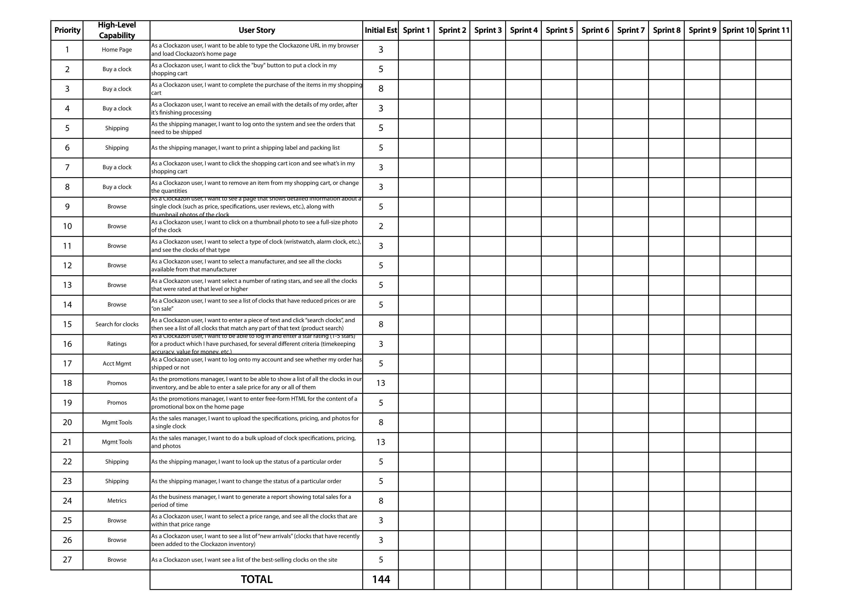

Slide 48
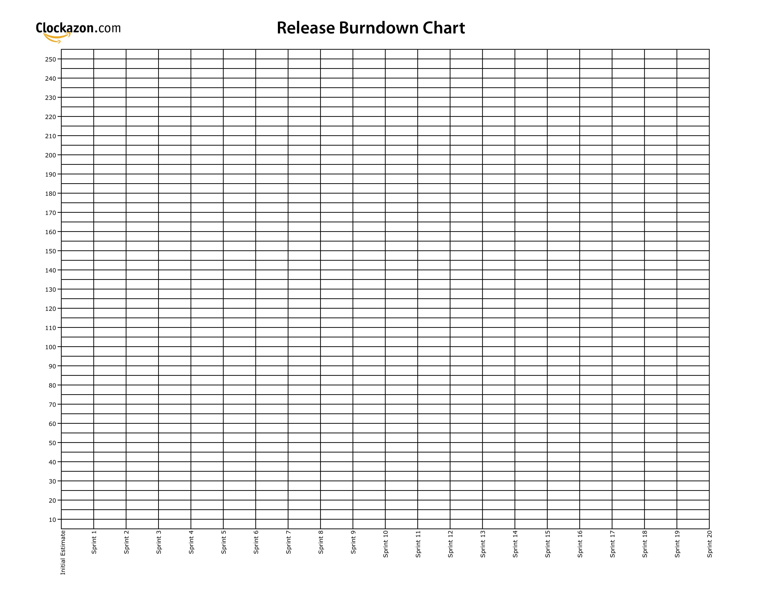
Proj Start
Dev End
Release

Slide 49

Proj Start
Dev End
Release
To release on time, remove 45 points of Backlog
To release full scope, 4 extra Sprints required

